Slide 1
Welcome to The Circles of Rosary
Peace Prayer Initiative
Linking
School
Family Church
To create one God’s Circle of Truth, Love & Peace
Each Circles of Rosary has a supporting role
in raising a community/culture of faith and peace loving nature.
“Peace in the name of God”, St. John Paul II
© The Circles of Rosary 905 896 2958 since 2007

Slide 2

The Circles of Rosary
Opening Prayer
Family
School
Church
In the name of the Father, of the Son, and of the Holy Spirit.
Dearest Mary, Jesus Christ,
St. John Paul II, and Mother Theresa, our peace models,
Enlighten us in caring and in loving our family
Help us to care, respect and love our siblings, Mom, Dad and elders.
Show us how to give without expecting a return or favour
Enlighten us how to value our family
With honesty, respect and peace at all times
Amen
© The Circles of Rosary 905 896 2958

Slide 3
The Apostles’ Creed
I believe in God,
The Father Almighty,
creator of heaven and earth,
And in Jesus Christ, his only Son, our Lord,
Who was conceived by the Holy Spirit, born of the Virgin Mary,
Suffered under Pontius Pilate,
was crucified, died, and was buried.
He descended into hell;
on the third day,
He rose again from the dead;
He ascended into heaven and is seated at the right hand of God the Father Almighty.
From there, He will come again to judge the living and the dead.
I believe in the Holy Spirit, the holy Catholic Church, the communion of saints, the forgiveness of sins, the resurrection of the body, and life everlasting.
Amen.

Slide 4
Our Father
Our Father, who art in Heaven,
Hallowed be thy name.
Thy kingdom come, thy will be done,
on earth as it is in Heaven.
Give us this day our daily bread,
and forgive us our trespasses,
As we forgive those who trespass against us
And lead us not into temptation
But deliver us from evil.
Amen.

Slide 5
Glory Be
Glory be to the Father,
And to the Son,
And to the Holy Spirit
As it was in the beginning,
Is now, and ever shall be
A world without end.
Amen.

Slide 6
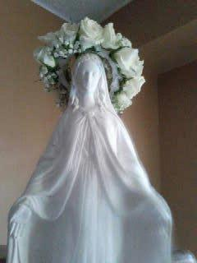
Hail Mary
Hail Mary, full of grace!
The Lord is with thee.
Blessed are thou amongst women,
And blessed is the fruit of thy womb,
Jesus.
Holy Mary, Mother of God,
Pray for us sinners
Now and until the hour of death.
Amen.

Slide 7
Fatima Prayer
O my Jesus,
Forgive us our sins,
Save us from the fires of hell,
Lead all souls to Heaven,
Especially those who need most of thy mercy

Slide 8
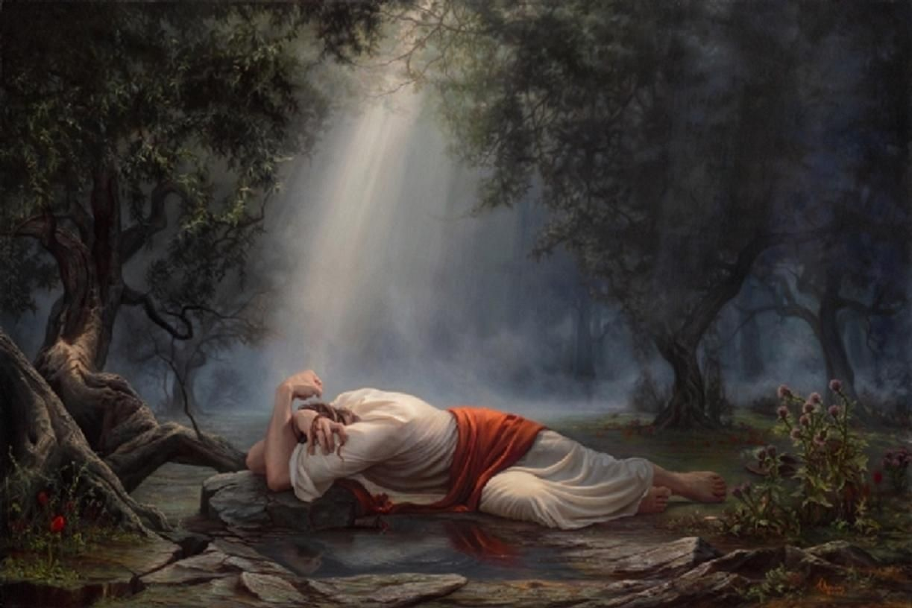
The First Sorrowful Mystery
Tuesdays and Fridays
The Agony in the Garden
Obtain for us, dearest Mother, from your Divine Son, the grace and power of the Holy Spirit
to be truly prayerful in order to recognize and to accept the Father’s will as Jesus did.
Intentions ______________

Slide 9
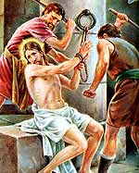
The Second Sorrowful Mystery
The Scourging at the Pillar
Obtain for us, dearest Mother, from your Divine Son, the grace and power of the Holy Spirit
to overcome any thought of violence. Instead choose to live in peace as Jesus showed us.
Intentions _____________________

Slide 10
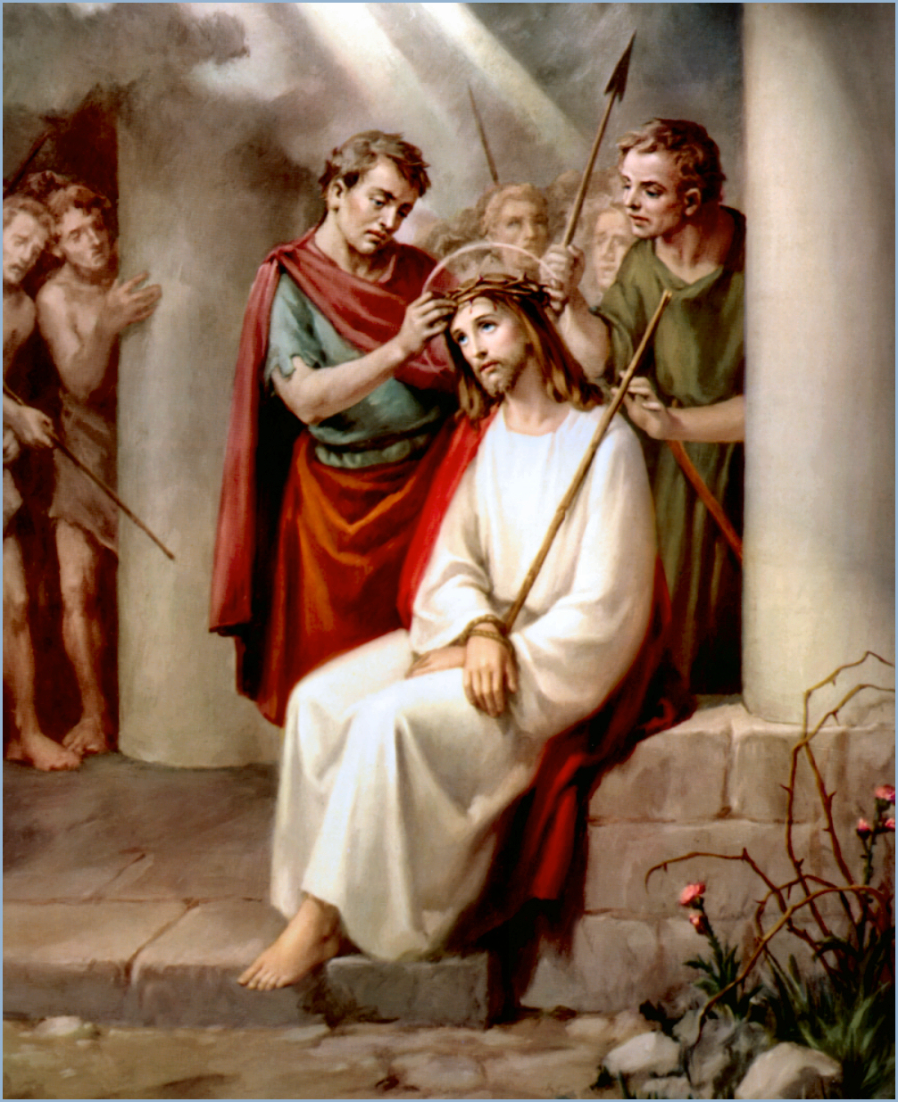
The Third Sorrowful Mystery
The Crowning with Thorns
Obtain for us, dearest Mother, from your Divine Son, the grace and power of the Holy Spirit
to stop pride ruling over our lives and become humble as Jesus did.
Intentions ____________________

Slide 11
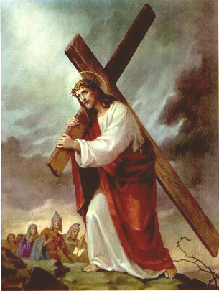
The Fourth Sorrowful Mystery
The Carrying of the Cross
Obtain for us, dearest Mother, from your Divine Son, the grace and power of the Holy Spirit
to overcome hate and anger and grow Christ’s love within us.
Intentions ___________________

Slide 12
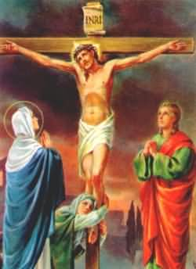
The Fifth Sorrowful Mystery
The Crucifixion and Death
of Jesus Christ
Obtain for us, dearest Mother,
from your Divine Son, the grace and
power of the Holy Spirit
to overcome feeling of revenge and choose forgiveness as
Christ did.
Intentions _____________________

Slide 13
Hail Holy Queen
Hail Holy Queen, Mother of Mercy,
hail our life, our sweetness and our hope,
to thee do we cry, poor banished children of Eve;
to thee do we send up our sighs, mourning, and weeping in this valley of tears.
Turn then, most gracious Advocate, thine eyes of mercy toward us,
and after this our exile,
show unto us the blessed fruit of thy womb, Jesus.
O Clement, O loving, O sweet Virgin Mary
Leader: Pray for us, O holy Mother of God
Response: That we may be made worthy of the promises of Christ. Amen.

Slide 14
Act of Consecration
O God, whose only begotten Son,
by His life, death, and resurrection,
has purchased for us the rewards of eternal salvation.
Grant we beseech Thee
that while meditating on these mysteries
of the most Holy Rosary of the Blessed Virgin Mary,
that we may both imitate what they contain,
and obtain what they promise,
through Christ our Lord. Amen.

Slide 15
The Circles of Rosary
Closing Prayer
Family
School
Church
Thank you, Lord, for blessing our home
A place of safety, comfort and peace
A family of unconditional love, forgiveness, mercy and acceptance.
Help our family to be peacemakers
like Mary, Jesus, St. John Paul II and Mother Theresa.
Make us remember
that peace and love around the world starts with you and me.
Amen

Slide 16
Let peace begin with me,
let this be the moment now
With every step I take,
Let this be my solemn vow
To take each moment
and live each moment
in peace eternally
Let there be peace on earth
and let it begin with me
- Jill Jackson & Sy Miller-
Let there be peace on earth and let it begin with me
Let there be peace on earth,
the peace that was meant to be
With God as our Father,
children all are we
Let us walk with each other
in perfect harmony

Slide 17
Print and fill in the slip below, your intentions will be included in the Prayer of the Faithful (collective), the community prays with you.
The Circles of Rosary
Family Circle Petition/Intention Slips
We pray for ________________________________________________________________
___________________________________________________________________________
We thank God for ___________________________________________________________
___________________________________________________________________________
Sts. Peter & Paul
Cristo Rei
St Dominic
church welcomes your family and prays with you at church on Saturday/Sunday masses. Please drop your family written intention slip in a round box marked “Family circle intention box”. The box is located at the foyer of the church. (you may sign or not sign your name).
Name of Participating School Circle _______________________ connecting with Family Circle, in turn connecting with the Church Circle. We are together at the church as One God Circle of Love, Peace & Joy.

